Slide 1
CNN Beyond ResNet - 1
李晓宇
2019.11.15

Slide 2
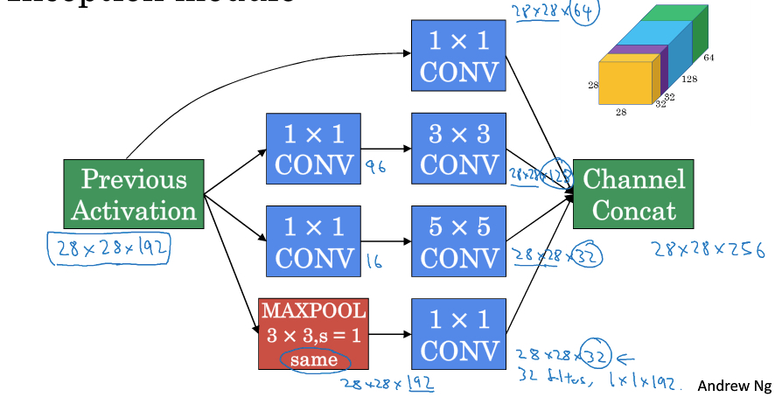
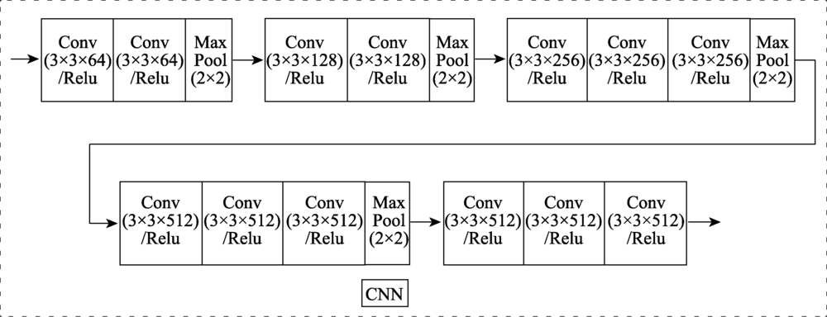
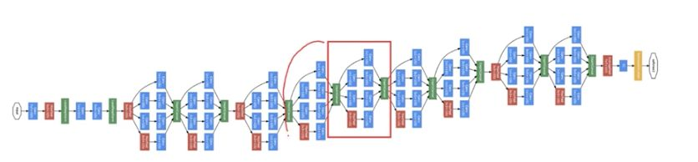
ResNext
VGG-16
Stacking building blocks of the same shape
Inception
Split-transform-merge strategy
Aggregated Residual Transformations for Deep Neural Networks, CVPR 2017, https://arxiv.org/abs/1611.05431

Slide 3
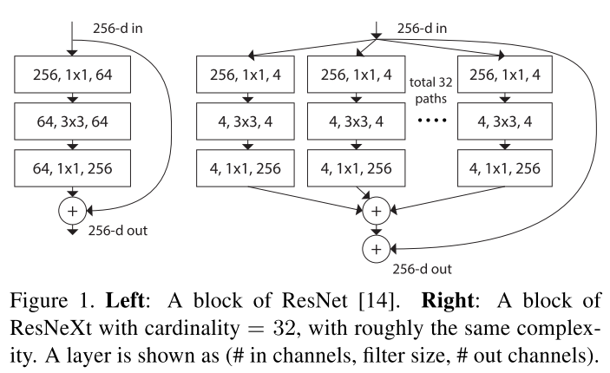
ResNext
the transformations to be
aggregated are all of the same topology (e.g., Fig. 1 (right)).
This design allows us to extend to any large number of transformations without specialized designs.
increase accuracy while maintaining
(or reducing) complexity
Our method indicates that cardinality (the size of the set of transformations) is a concrete, measurable dimension that is of central importance, in addition to the dimensions of width and depth.

Slide 4
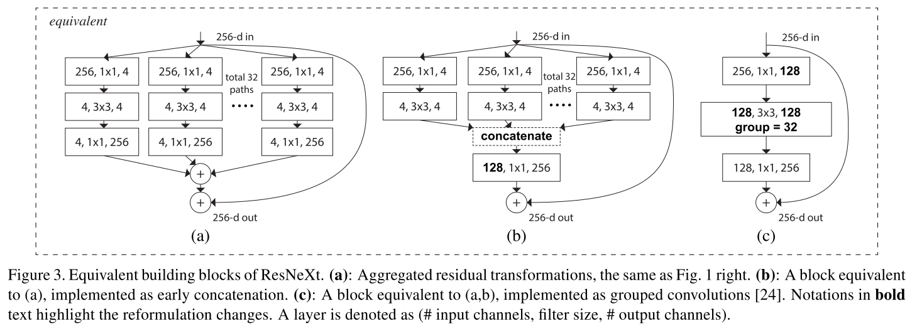
ResNext

Slide 5
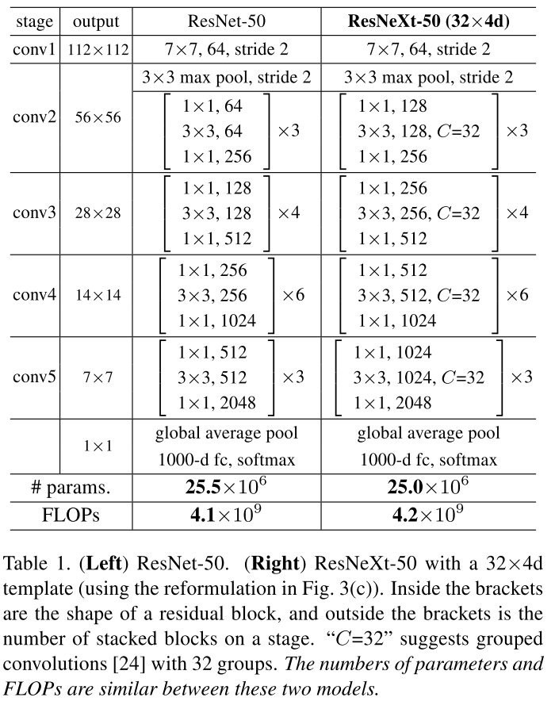
ResNext

Slide 6
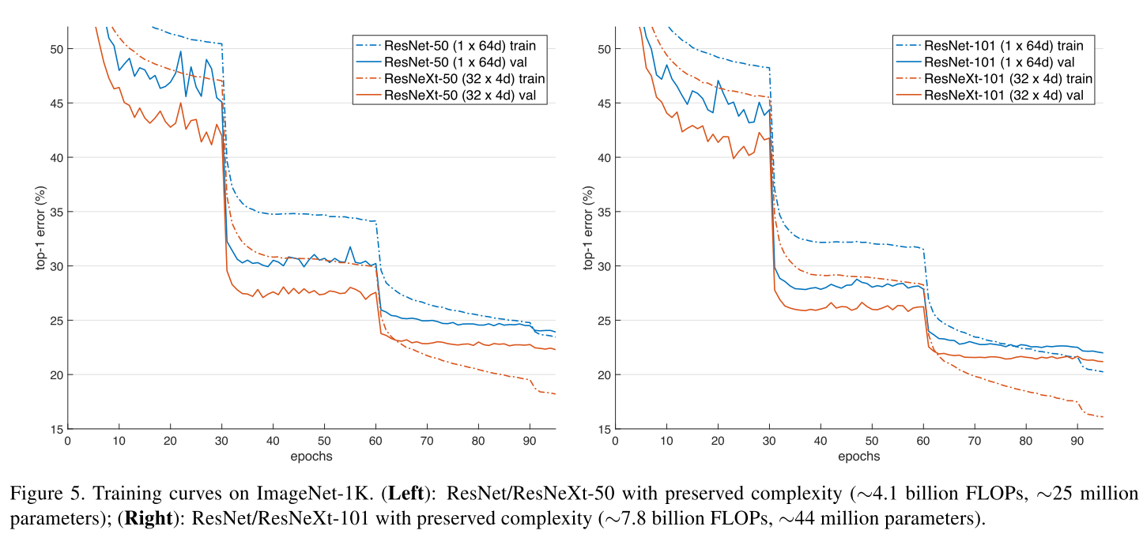
ResNext

Slide 7
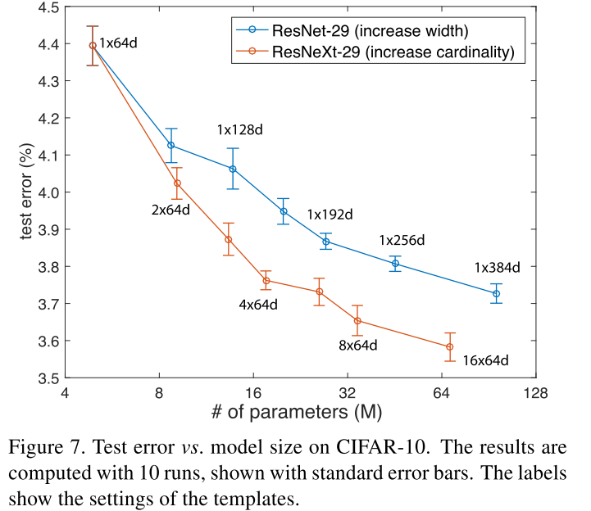
ResNext

Slide 8
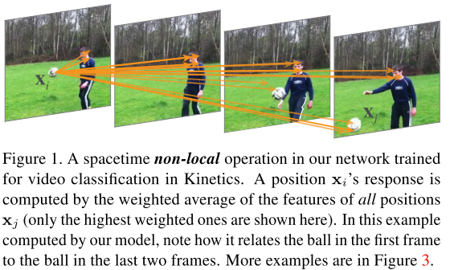
Non-local Neural Networks
Inspired by the classical non-local means method [4] in computer vision, our non-local operation computes the response at a position as a weighted sum ofthe features
at all positions.
Non-local Neural Networks, CVPR 2018, https://arxiv.org/abs/1711.07971

Slide 9
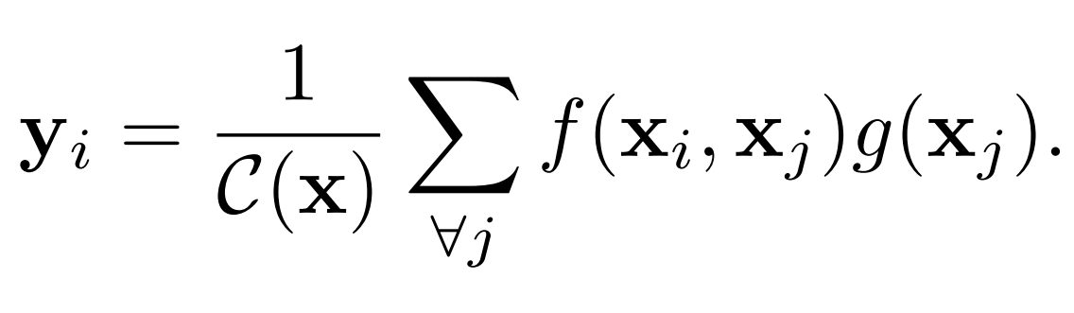
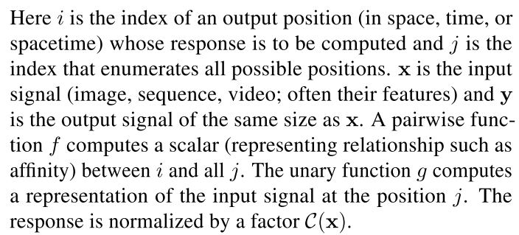
Non-local Neural Networks

Slide 10
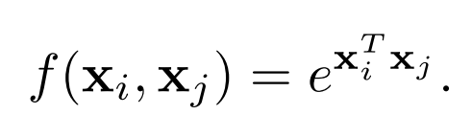
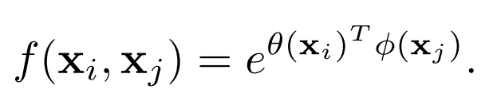

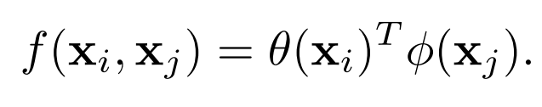
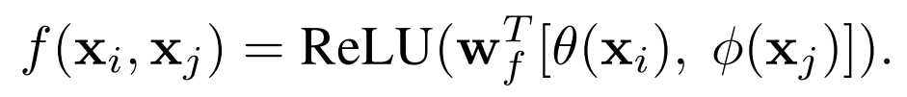
Non-local Neural Networks
Special case --
Self-attention in transformer:

Slide 11
Non-local Neural Networks
Special case --
Self-attention in transformer:
Non-local models are not sensitive to these choices, indicating that the generic non-local behavior is the main reason for the
observed improvements.

Slide 12
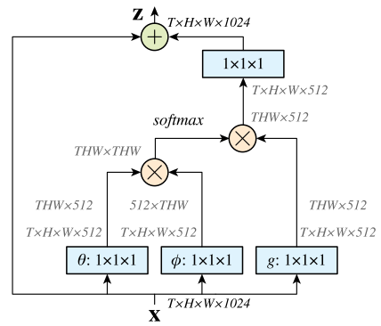
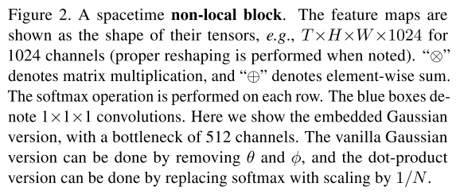
Non-local Neural Networks

Slide 13
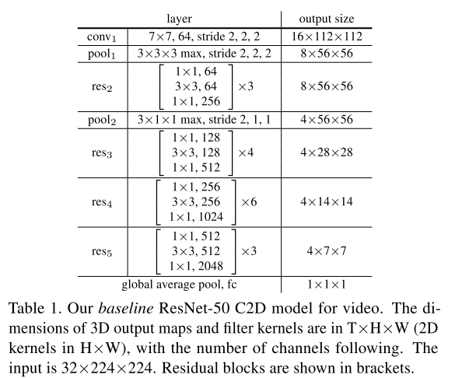

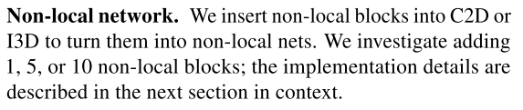
Non-local Neural Networks

Slide 14
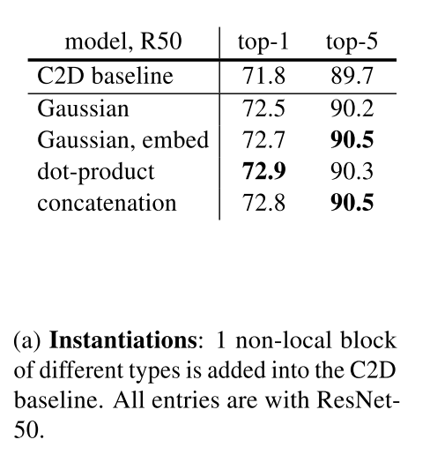
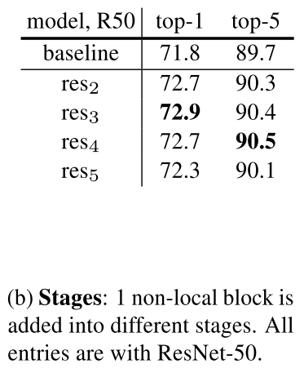
Non-local Neural Networks

Slide 15
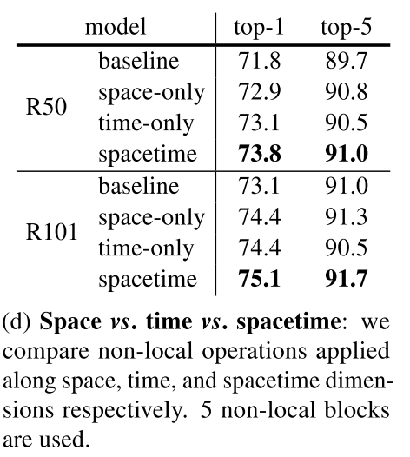
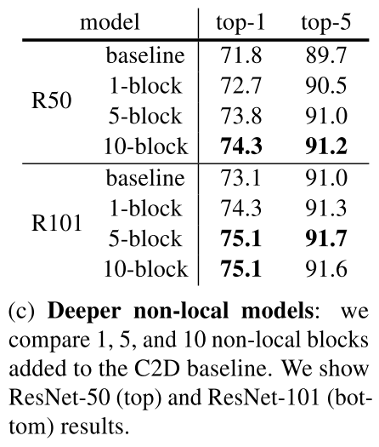
Non-local Neural Networks

Slide 16
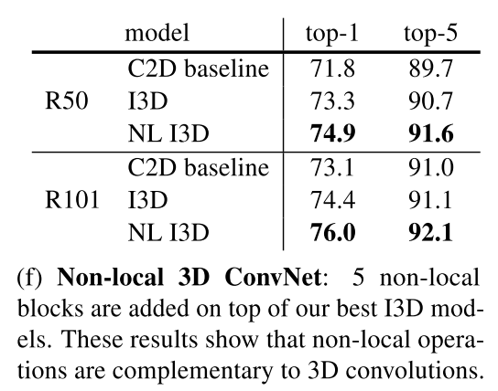
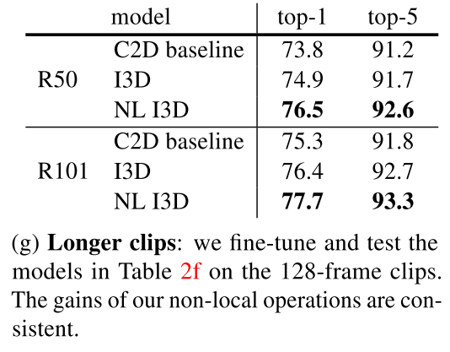
Non-local Neural Networks

Slide 17
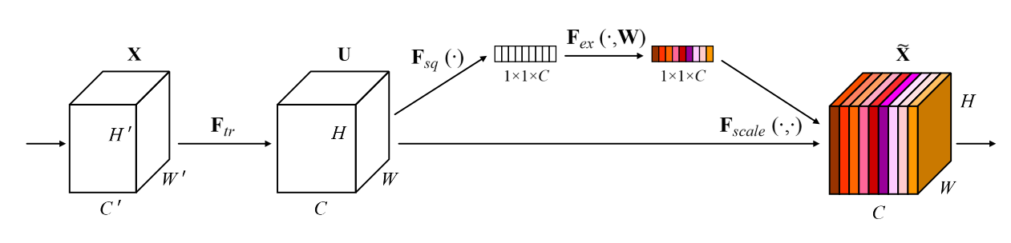
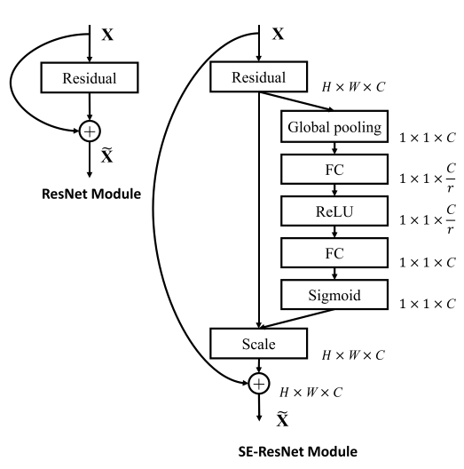
SENet

Slide 18
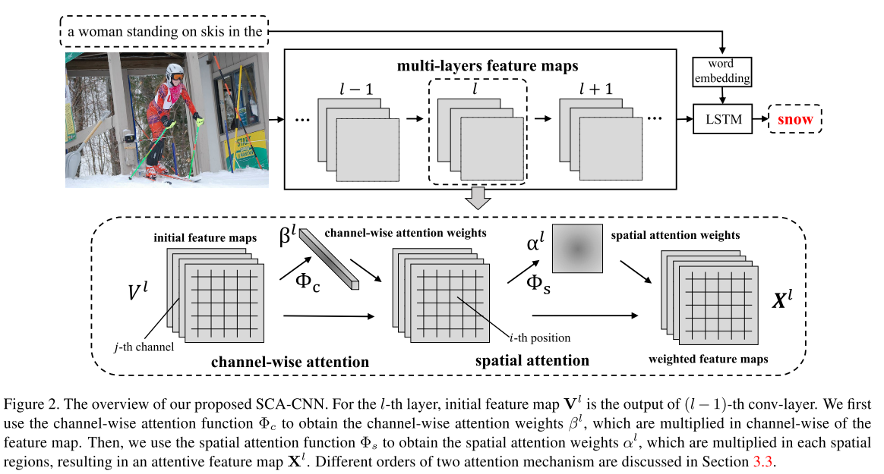


SCA-CNN

Slide 19
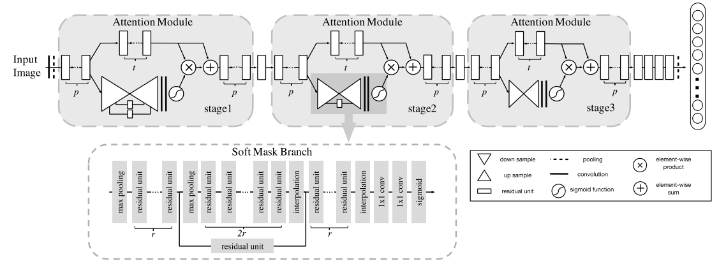

Residual Attention Network

Slide 20
Thanks.
Q&A

